Slide 1
Introduction

Slide 2
1.1 Data Communication

Slide 3
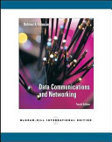
Course’s TextBook
Data Communication and Networking, Behrouz Forouzan, McGrawHill,
5 Edition , 2013

Slide 4
Definitions
Data: information presented in whatever form is agreed upon by the parties creating and using the data.
Data Communication: exchange of data between two devices via transmission medium (wire cable / link).
Data Communication System: Made up of a combination of hardware (physical equipment) and software (programs) to facilitate for effective communication of data.

Slide 5
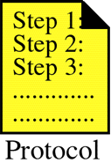
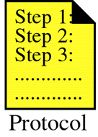




5 Components of a Data Communication System
Figure 1-1
Protocol: is a set of rules that governs data communications. It represents an agreement between the communicating devices. Without a protocol two devices may be connected but not communicating.

Slide 6
Characteristics of a Data Communication System
Delivery : System must deliver data to correct destination. Data must be received by only intended device or user.
Accuracy: The system must deliver data accurately
Timeliness: the system must deliver data in a timely manner. Data delivered later are useless.
Jitter: Variation in the packet arrival time. It is the uneven delay in the delivery of audio or video packets.

Slide 7
Data Flow
Path taken by data within a device, network, or organization, as it moves from its source to its destination (a data repository or a data user).
Categorized by direction of flow:
  Simplex
  Half-duplex
  Full-duplex

Slide 8
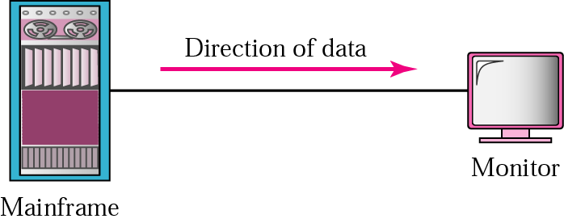
Simplex
Communication is unidirectional, one of the two devices on a link can transmit; the other can only receive (one-way street).
Ex: keyboard (input), monitors (output)

Slide 9
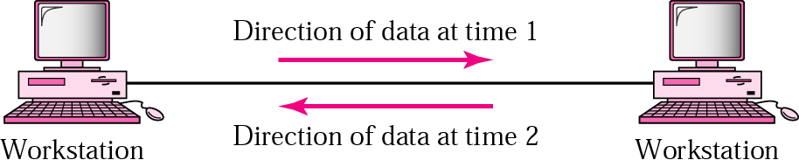
Half-duplex
Each station can both transmit and receive , but not at the same time. When one device is sending the other can receive and vice versa. (one-lane road with two direction).

Slide 10
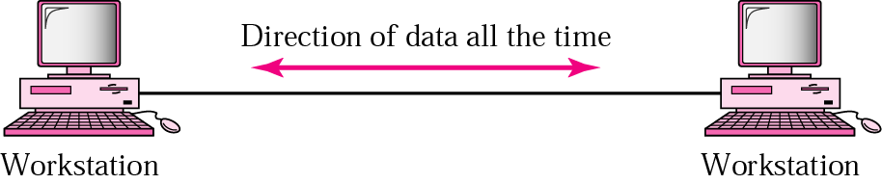
Full-duplex
Both stations can transmit and receive simultaneously. (two way street with traffic flowing in both directions at the same time).
Ex: telephone network.
Signals going in either direction share the capacity of the link in two ways:
Either the link must contain two physically separate transmission paths one for sending and other for receiving.
Capacity of the channel is divided between signals traveling in both direction

Slide 11
1.2 Networks

Slide 12
Definitions
A network is a set of devices (often referred to as nodes) connected by communication links.
A node can be a host (such as a computer, a laptop, a smart phone etc.) or a network device (such as a switch, a router, etc.).
A link is a communication pathway that transfer data from one device to another.

Slide 13
Network Criteria
A network must be able to meet a certain number of criteria.
  Performance
  Reliability
  Security

Slide 14
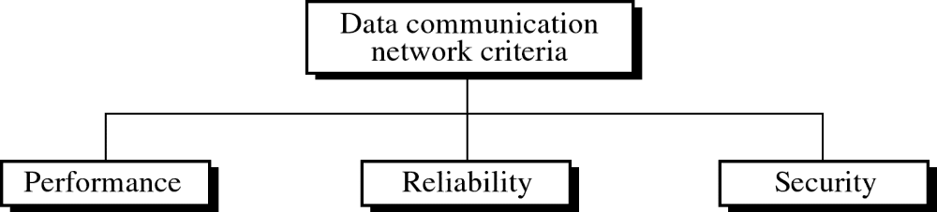
Figure 1-2
WCB/McGraw-Hill
© The McGraw-Hill Companies, Inc., 1998

Slide 15
Performance
Can be measured in many ways!
  Transmit time: the amount of time required for a message to travel from one device to another.
  Response time: the elapsed time between an inquiry and a response.
Often evaluated by two networking metrics: throughput and delay.

Slide 16
Factors Affecting Performance
  Type of transmission media,
  Capabilities of connected H.W and the efficiency of software.
  Number of user

Slide 17
Throughput
Throughput is an important network metric-also known as bandwidth.
The bandwidth of a network is given by the number of bits that can be transmitted over the network in a certain period of time.
Depends on the network technology (hardware capabilities) and therefore is constant.

Slide 18
Throughput Example
A network might have a bandwidth of 10 million bits/second (Mbps), meaning that it is able to deliver 10 million bits every second.

Slide 19
Delay
Also known as latency.
corresponds to how long it takes a message to travel from one end of a network to the other.
Latency is measured strictly in terms of time.
Effected by number of users and hence may change from time to time.

Slide 20
Delay Example
A transcontinental network might have a latency of 24 milliseconds (ms); that is, it takes a message 24 ms to travel from one end of North America to the other.

Slide 21
Network Criteria
A network must be able to meet a certain number of criteria.
  Performance
  Reliability
  Security

Slide 22
Reliability
Accuracy of delivery.
Measured by:
  Frequency of failures
  Time it takes to recover from a failure
  The network’s robustness in a catastrophe.

Slide 23
Network Criteria
A network must be able to meet a certain number of criteria.
  Performance
  Reliability
  Security

Slide 24
Security
Many issues at the different layers!
Examples:
  Protecting data from unauthorized access.
  Protecting data from damage.
  Implementing policies and procedures for recovery from breaches and data losses.

Slide 25
Network Configuration
There are a number of ways that computers can be connected together to form networks.
Physical attributes of a network include:
  Type of connection
  Physical topology

Slide 26
Type of Connection
For communication to occure, two devices must be connected in someway to the same link at the same time.
Two possible connections:
  Point-to-point
  Multipoint

Slide 27
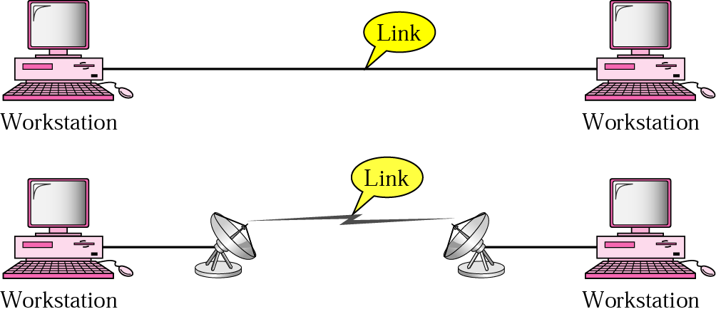
Physical Structures: Type of connection
1. Point –to-point
Dedicated link between two devices. Most of them uses an actual length of wire or cable to connect the two ends but other options ,such as microwave satellite are possible.

Slide 28

Physical Structures: Type of connection
2. Multipoint
Is one in which more than two specific devices share a single link

Slide 29
Links
Each node needs one interface for each link.
point-to-point
(a)
multiple-access
(b)
Geographical coverage and scalability are limited.
1/18/2006
CSCI 363 Computer Networks

Slide 30
Network Configuration
Physical attributes of a network include:
  Type of connection
  Physical topology

Slide 31
Physical Topology
Two or more links for a topology.
  The topology of a network refers to the geometric representation of the relationship of all the links and linking devices (nodes) to one another.
The term physical topology refers to the way in which a network is laid out physically.

Slide 32

Physical Topology
The way in which a network is laid out physically.

Slide 33
Mesh Topology
Every device has a dedicated point-to-point link with every other device on the network.
link carries traffic only between the two devices.

Slide 34
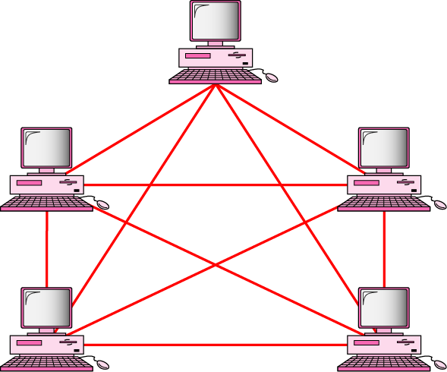
Fully connected mesh topology (for five devices)
Every device has a dedicated point-to-point link to every other devices
Fully connected mesh network has n(n-1)/2 physical connection to link n devices.
Every device on the network must have n-1 input/output (I/O) ports

Slide 35
Advantages of a Mesh topology
Privacy or security (every message travels along a dedicated line, only the intended recipient sees it. Physical boundaries prevents other user from gaining access the message
eliminating the traffic problems The use of dedicated links guarantees that each connection can carry its own data load; that can occur when links must be shared by multiple devices.

Slide 36
Advantages of a Mesh topology
A mesh is robust. If one link becomes unusable, it does not incapacitate the entire system.
Fault identification and fault isolation easy. This enables the network manager to discover the precise location of fault and aids in finding its cause and solution.

Slide 37
Disadvantages of a Mesh topology
Related to the amount of cabling devices and the amount of I/O ports required:
  Every device must be connected to every other device, installation and reconnection are difficult
  The sheer bulk of the wiring can be greater than the available space can accommodate.
  The H.W required to connect each link (I/O ports and cable) expensive.

Slide 38
Disadvantages of a Mesh topology
  So a mesh topology is usually implemented in a limited fashion( as a backbone connecting the main computers of a hybrid network that can include several other topology

Slide 39
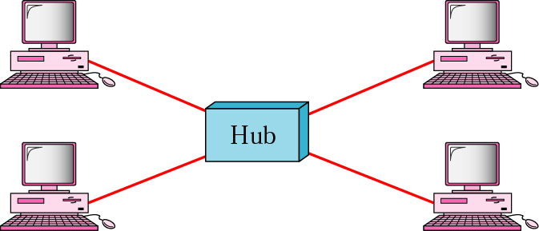
Star topology
Each device has a dedicated point-to-point link only to a central controller (hub)
Unlike a mesh , a star topology does not allow direct traffic between devices, if one device want to send data to another , it send it to the hub, which send it to other device

Slide 40
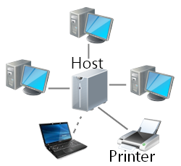
The star pattern connects everything to a host computer, a network switch, or a network hub, which handles the network tasks.
All communications
between computers
go through the
host/switch/hub.

Slide 41
Advantages of a Star topology
1.Easy to install and reconfigure and less expensive
  each device need only one link and I/O port to connect it to any other devices.)
2.Robustness:
  if one link fails, only that link affected and other links remain active.
3.identification and fault isolation

Slide 42
Disadvantages of a Star topology
The dependency of the whole topology on one single point, the hub. If the hub goes down, the whole system is dead.

Slide 43

Tree topology : Is a variation of star
- Not every device plugs directly into the central hub. The majority of devices connect to secondary hub that in turn is connected to the central hub.

Slide 44
Tree topology : Is a variation of star
The advantages and disadvantages of tree topology are generally the same as those of star .
- The addition of secondary hubs bring more advantage: allows for more devices to be attached to a single central hub, therefore increase the distance a signal can travel between devices.

Slide 45
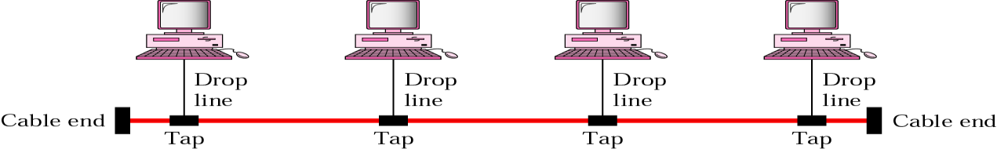
Bus topology
•Multipoint connection. Acts as a backbone to link all the devices in a network.

Slide 46

The bus pattern connects the computer to the same communications line. Communications goes both directions along the line. All the computers can communicate with each other without having to go through the server.

Slide 47
Bus topology
There is a limit on the number of taps a bus can support and on the distance between those taps
As a signal travels along the backbone, it becomes weaker

Slide 48
Advantages of a Bus topology
  Ease of instulation, use less cabling than mesh or star.
-

Slide 49
Disadvantages of a Bus topology
1. A fault in bus cable (break) stops all transmissions even between devices on the same side of the problem. The damaged area reflects signals back the direction of origin, creating noise in both directions
2. Reconnection
It can difficult to add new devices (adding more require modification or replacement of the backbone).

Slide 50
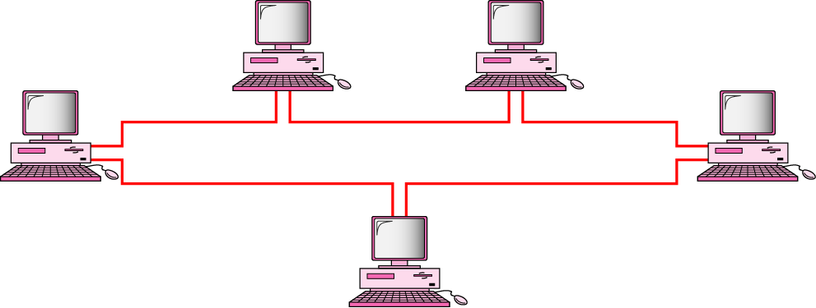
Ring Topology
Each device has a dedicated point-to-point connection only with the two devices on either side of it
A signal is passed along the ring in one direction from device until it reaches its destination.

Slide 51
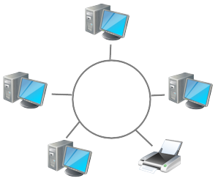
The ring pattern connects the computers and other devices one to the other in a circle.
There is no central host computer that holds all the data.
Communication flows in one direction around the ring.

Slide 52
Ring Topology
Each device in the ring incorporate as repeater
Repeater :regenerates the signal
it receives a weakened signal, creates a copy, bit for bit, at the original strength

Slide 53
Ring Topology
Advantages:
Easy to install and reconfigure.
  Each device is linked only to its immediate neighbors. To add or delete a device requires hanging only 2 connections
Fault isolation is simplified :
  A signal is circulating at all times (token) if one device does not receive a signal within specified period, it can issue an alarm. The alarm alerts the network operator to the problem and its location
Disadvantages
Unidirectional traffic.
  A break in the ring (such as disabled station) can disable the entire network. This can be solved by use dual ring

Slide 54
Advantages of a Ring Topology
Easy to install and reconfigure.
Each device is linked only to its immediate neighbors. To add or delete a device requires hanging only 2 connections
Fault isolation is simplified :
A signal is circulating at all times (token) if one device does not receive a signal within specified period, it can issue an alarm. The alarm alerts the network operator to the problem and its location

Slide 55
Disadvantages of a Ring Topology
Unidirectional traffic.
  A break in the ring (such as disabled station) can disable the entire network. This can be solved by use dual ring

Slide 56

A hybrid topology: a star backbone with three bus networks

Slide 57
Networks Models
Computer networks are created by different entities.
Standards are needed so that these heterogeneous networks can communicate.
The two most know standards:
  OSI model: defines a seven layer network.
  Internet model: defines a five layer network.

Slide 58
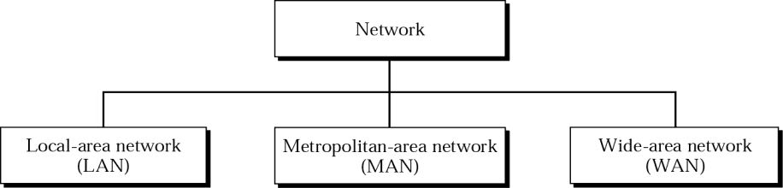
Network Categories
Network category is determined by its size, ownership, the distance it cover and its physical architecture.

Slide 59
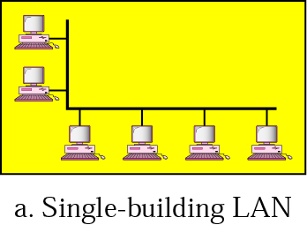
Single-Building LAN
Used in business environments, links a workgroup of task-related computer.

Slide 60
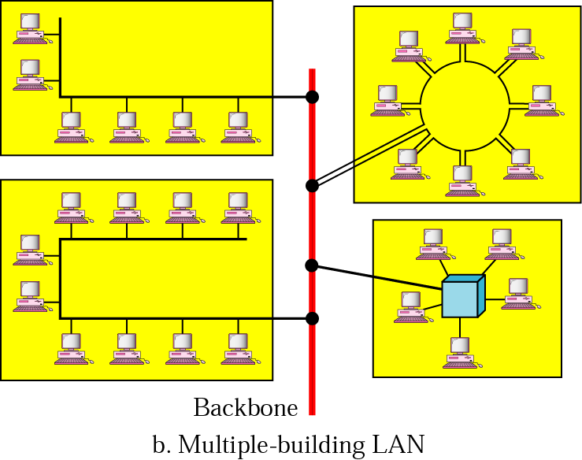
Multiple-building LAN

Slide 61
LAN ( Local Area Network)
Privately owned and links the devices in a single office, building or campus
LANs designed to allow resources to be shared between PCs or workstations. The resources may be H.W (e.g. printer) or S.W (applications program) or data.
In LANs one of the computers has a large capacity drive and becomes a server to other clients.

Slide 62
LAN ( Local Area Network)
S/W stored on server and used as needed by the whole group.
LAN size determined by licensing restrictions (no of users per copy of S/W)
LAN use only one type of transmission medium.
The most common LAN topologies are bus, ring and star.

Slide 63
LAN ( Local Area Network)
Traditionally LAN have data rates in the 4 to 16 Mbps. Today Speed can reach to 100Mbps or 1000MBps(1G).

Slide 64
MAN (Metropolitan Area Network)
Owned by private company or it may be a service provided by public company ( such as local tel.-company)
Extended over an entire city.
May be single network such as a cable television network, or it may be connected number of LANs into a large network so that resources may be shared LAN-TO- LAN.

Slide 65
MAN (Metropolitan Area Network)
Examples:
  Company can use MAN to connect the LANs in all its offices throughout the city.
  A part of the telephone line network that can provide DSL line to the customer

Slide 66
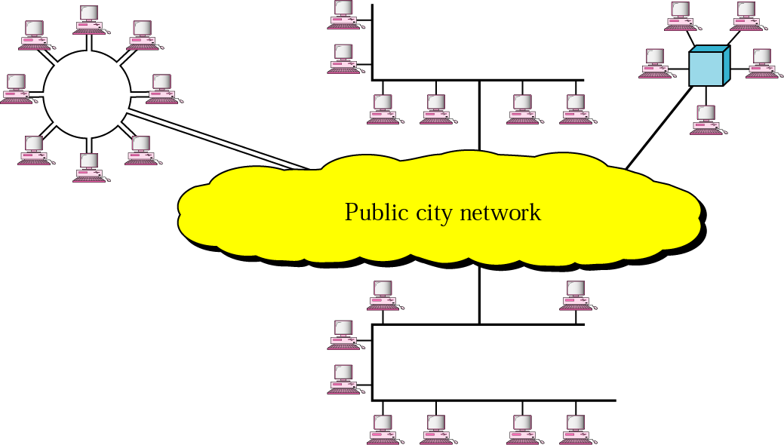
MAN

Slide 67
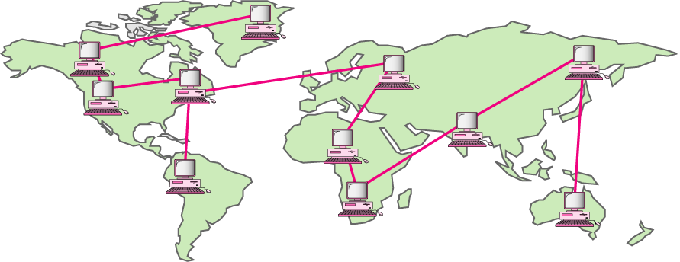
WAN (Wide Area Network)
Provides long distance transmission of data, voice , image and video information over large areas ( country or whole world)
In contrast to LAN, WAN may utilize public or private communication equipments or combination.

Slide 68
Interconnection of Networks: Internetwork
An internet (small i) is two or more networks that can communicate with each other.

Slide 69
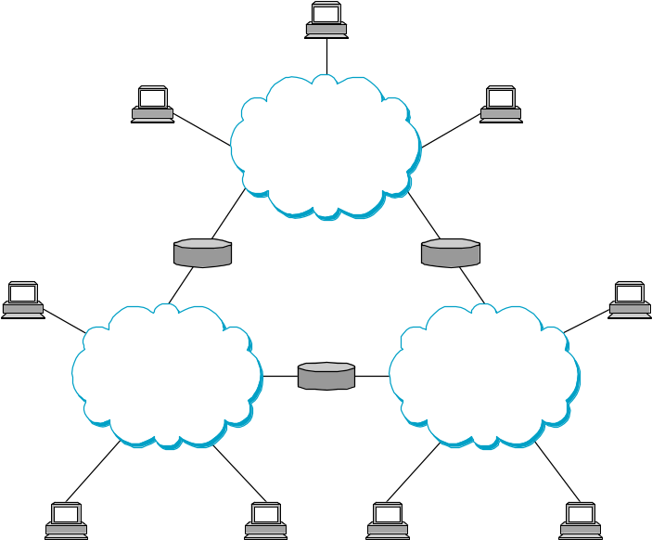
Internetworking
To interconnect two or more networks, one needs a gateway or router.
Host-to-host connectivity is only possible if there’s a uniform addressing scheme and a routing mechanism.
Messages can be sent to a single destination (unicast), to multiple destinations (multicast), or to all possible destinations (broadcast).
1/18/2006
CSCI 363 Computer Networks

Slide 70
